Slide 1

Heart Failure Prediction
Saving Lives
Submitted By:
Manoj Kumar Nallamala

Slide 2
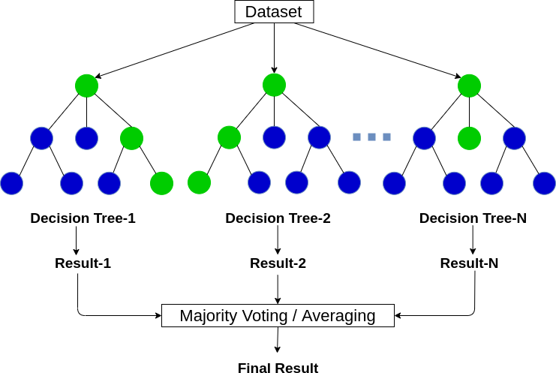
Model Selection
Random Forest:
A random forest is a machine learning technique that’s used to solve regression and classification problems.
As we have discussed before, multiple decision trees can be constructed on the same dataset. Random forest aggregates all possible trees than can be constructed and decides the final outcome based on the majority vote of the individual trees.

Slide 3
Model Analysis
We have used RandomForestClassifier function from sklearn open source package.
A decision tree is a popular classification structure used in machine learning. It is
a map of the possible outcomes of a series of related choices.
A decision tree typically starts with a single node, which branches into possible outcomes. Each of those outcomes leads to additional nodes, which branch off into other possibilities. This gives it a treelike shape.
Multiple decision trees can be constructed on same dataset.
Picking the best tree from the constructed trees will lead us to a even better model for predicting heart failure. We have constructed 10 different decision trees, which can be passed as value for argument “ n_estimators”.
We have used criterion as “entropy” which is a measure of chaos within the node. And chaos, in the context of decision trees, is having a node where all classes are equally present in the data

Slide 4
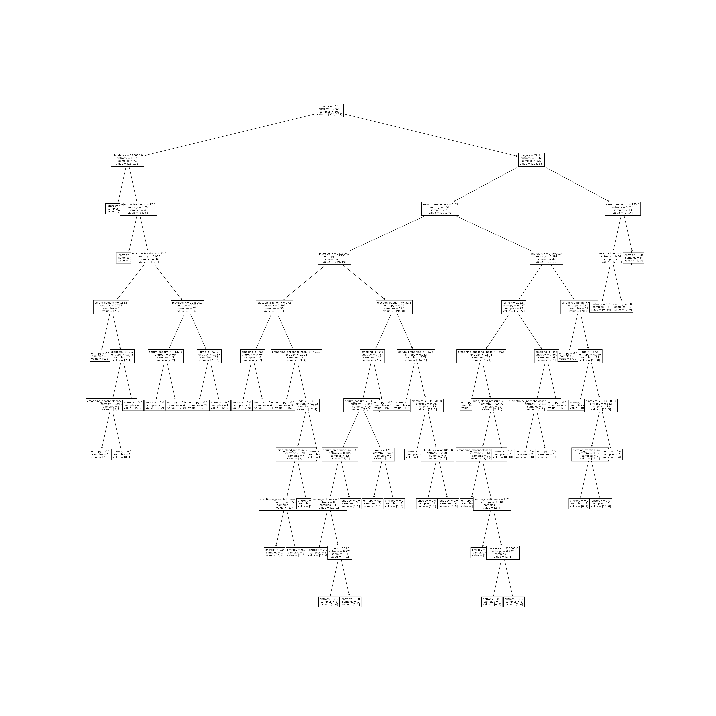

Slide 5
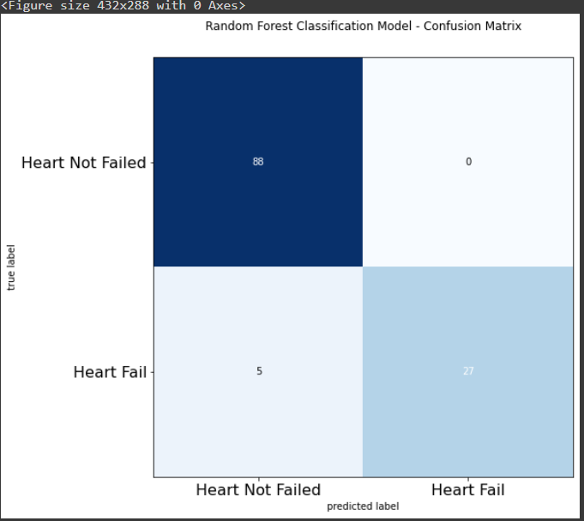
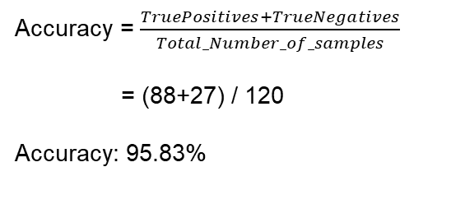
Confusion matrix evaluation for Random Forest
Confusion matrices are used to visualize important predictive analytics like recall, specificity, accuracy, and precision.
Confusion matrices are useful because they give direct comparisons of values like True Positives, False Positives, True Negatives and False Negatives
Accuracy = $\frac{TruePositives+TrueNegatives}{Total_Number_of_samples}$
= (88+27) / 120
Accuracy: 95.83%

Slide 6
Conclusion
As observed from the results of various models that we used, Random Forest algorithm gave the best accuracy (95.8%) for the predictions.
Decision tree models have second best performance among the remaining models with an accuracy of 93.3%.
It is quite obvious as to why Random Forest performed better than Decision Tree model because it builds on decision trees and overcomes the shortcomings of individual trees.
Random Forest also performs better on large datasets compared to many other algorithms in machine learning.

